Slide 1
Big Data Analysis using Sparklyr
Emad Toubar (b00073720)

Slide 2

Outline
Introduction to Spark
Getting Started with Sparklyr
Summary of Machine Learning
Machine Learning using Sparklyr
Data Visualization with Sparklyr

Slide 3

What is Spark?
Apache Spark is an open-source software specifically designed to handle big data analysis
Utilizes in-memory caching and optimized query execution

Slide 4
Why use Spark?
Spark is a much faster alternative to MapReduce, which was the traditional method used with Apache Hadoop to process big data
This is because Spark contains Resilient Distributed Datasets, which allows it to read and write data at a much faster rate. It also much faster because it stores its data in the RAM instead of relying on disk drives
Spark is also a very diverse analytics tool as it relies on many components including machine learning algorithms and SQL queries

Slide 5
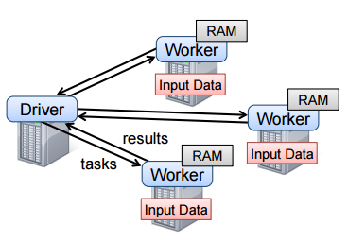
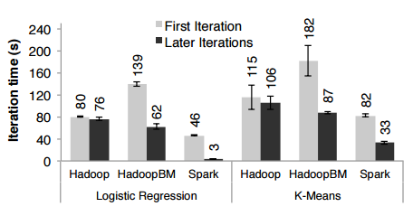
Resilient Distributed Dataset (RDD)
An immutable collection of different partitioned elements of a dataset stored mostly on the RAM
Designed to handle iterative algorithms efficiently with as minimal iteration time as possible
Best used for programs that apply the same operations to all the elements of a dataset

Slide 6
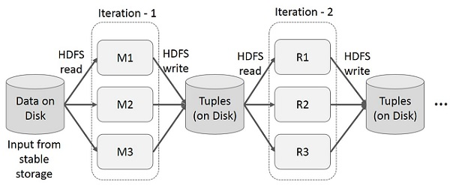
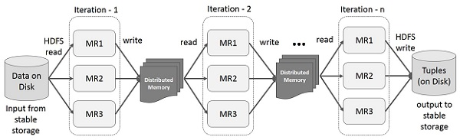
Spark
MapReduce

Slide 7
The Five Components of Spark
Spark Core
Spark Core is the foundation of the Apache Spark program, and it provides the most important features such as in-memory computing.
Spark SQL
Spark SQL is a component in Spark that provides an interface for working with SQL databases.
Spark Streaming
Spark Streaming is the Spark component that allows for the real-time streaming of data and processing it so it can be outputted to databases and file systems.
MLlib
MLlib is the machine learning library of Spark that allows for the use of many ML algorithms including K-means clustering, regression, classification, etc.
GraphX
GraphX allows the user to visualize all the computations made in Spark.

Slide 8

What is Sparklyr?
An open-source package in RStudio that allows for the easy integration of Spark
Allows using Spark as a backend for dplyr, making data manipulation much quicker
Provides access to distributed machine learning in RStudio through Spark MLlib

Slide 9
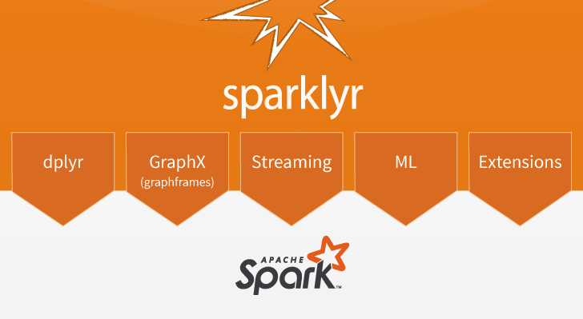

Slide 10
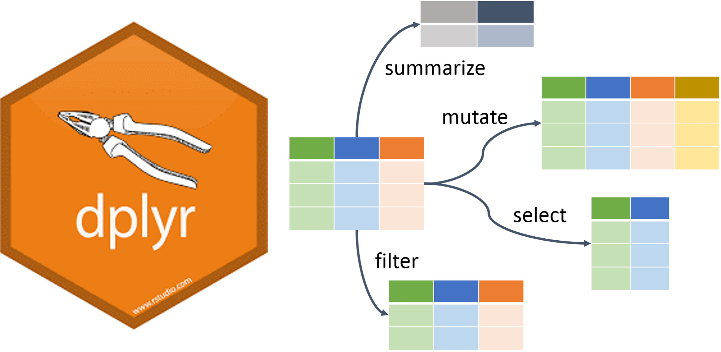
dplyr
A powerful data manipulation tool that allows for many different type of operations on a dataset
The following are some of the functions you can use in dplyr:
mutate()
select()
filter()
summarize()
arrange()

Slide 11
Getting Started with Sparklyr
In order to start using sparklyr in RStudio you must first install the package by using the following command:
install.packages("sparklyr")
After installing the package, you must also install a local version of Spark through the following command:
library(sparklyr)
spark_install(version = "2.1.0")

Slide 12
Sparklyr Demo
Let’s see how we can apply all that we’ve learned so far in RStudio

Slide 13

Machine Learning
“An application of artificial intelligence that provides systems the ability to automatically learn and improve from experience without being explicitly programmed.”
Machine learning algorithms can be divided into two main categories:
Supervised ML: Requires labels to predict
Unsupervised ML: Does not require labels to predict

Slide 14
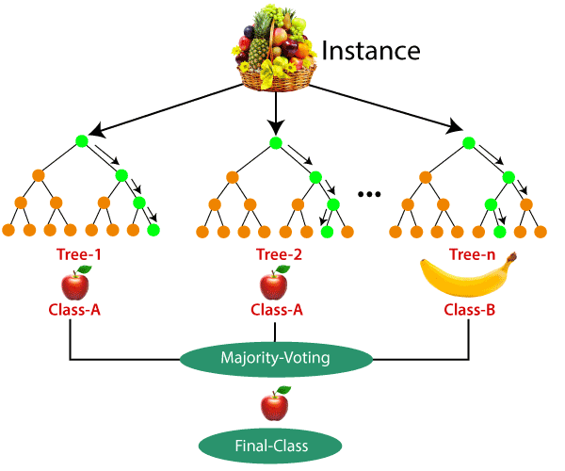
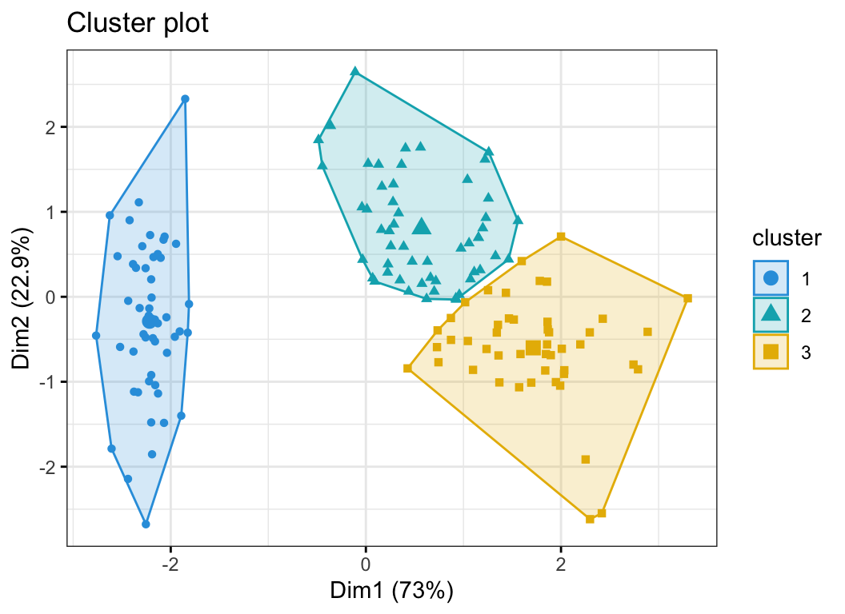
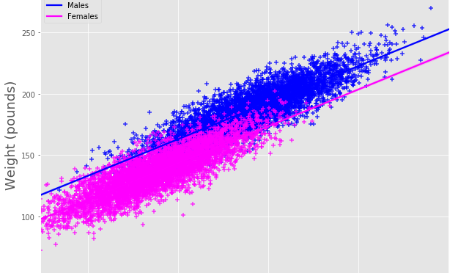
Machine Learning Algorithms
K-Means Clustering: an ML algorithm that groups data points into clusters based on similarities between them
Linear Regression: a supervised ML algorithm that models the relationship between continuous variables by fitting a linear equation
Random Forest: an ML algorithm that uses many decision trees to classify a certain data point

Slide 15
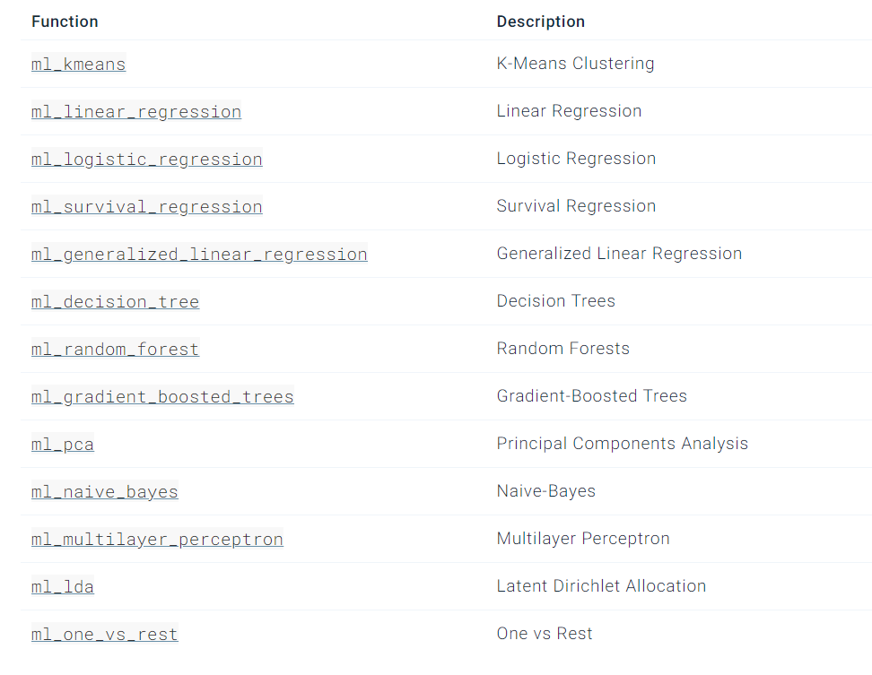
Machine Learning using Sparklyr

Slide 16
Machine Learning Demo
Time to head to RStudio to see how we can apply some machine learning methods with Spark and dplyr

Slide 17
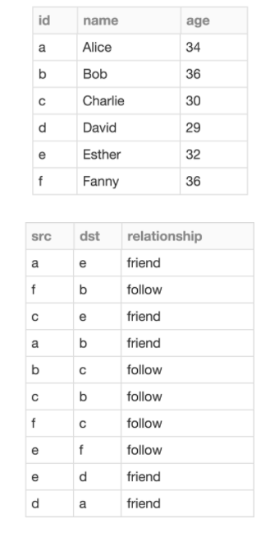
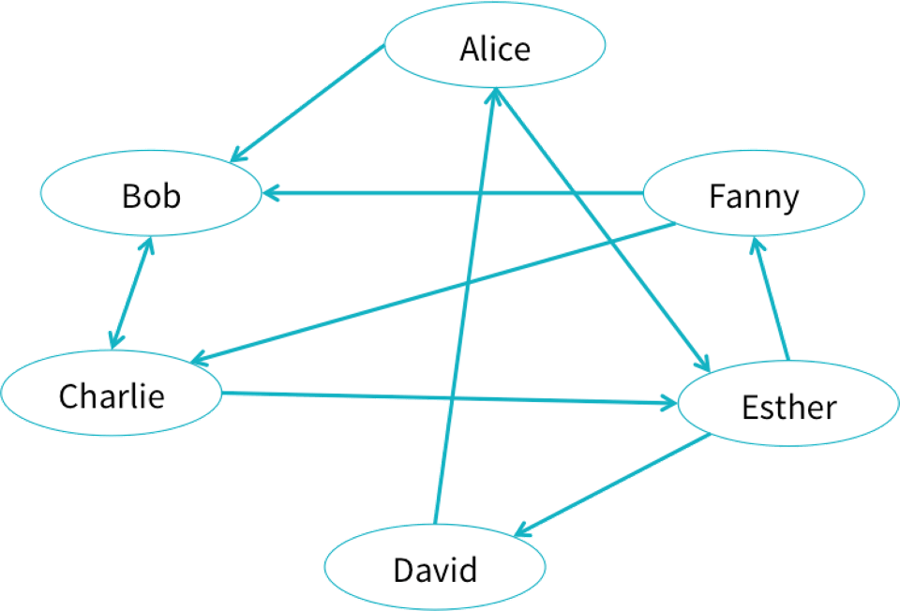
GraphFrames
Built upon Spark’s GraphX package to provide a uniform API for graph processing
The vertices and edges in GraphFrames are represented as dataframes

Slide 18
Visualization Demo

Slide 19
To access all the material from this presentation
https://github.com/Emad-T/sparklyr-MTH243

Slide 20



Thank you
References:
spark.rstudio.com
https://chartio.com/learn/data-analytics/what-is-spark/
https://dplyr.tidyverse.org/
https://databricks.com/glossary/sparklyr
https://databricks.com/blog/2016/03/03/introducing-graphframes.html
https://towardsdatascience.com/11-most-common-machine-learning-algorithms-explained-in-a-nutshell-cc6e98df93be

